Slide 1
Coding Style & Comment Rule
KSDK validation team
Jolly Li and Summer Guo
July.09.2014

Slide 2
Agenda
File structure and source code file name
Standard Types
Naming conventions
Formatting
Language rule
Grammar rule

Slide 3
File structure and source code file name

Slide 4
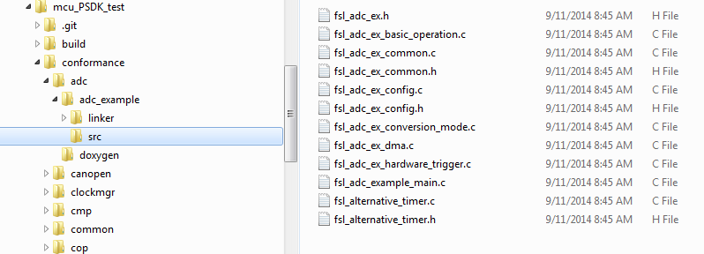
File structure
Add src files in following path:
mcu_PSDK_test\conformance\module\module_example\src\

Slide 5
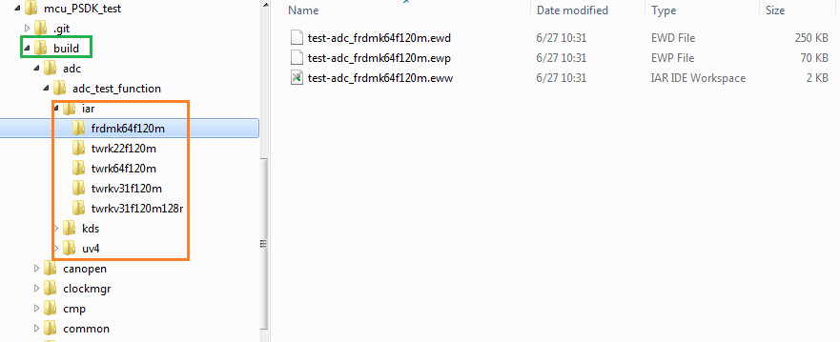
File structure
2. Modify yml files to generate IDE project.
When modify yml files correctly and generate project successfully, you can find your project in below path: mcu_PSDK_test\build.

Slide 6
Source code file name and structure
fsl_i2c_example_main.c
# the main function
fsl_i2c_ex.h
# the example function prototype
fsl_i2c_ex_config.h
# the configuration for the example such supported platforms for examples
fsl_i2c_ex_send_receive_interrupt.c
fsl_i2c_ex_acce_interrupt.c
fsl_i2c_ex_acce_polling.c
fsl_i2c_ex_send_receive_polling.c
#the special example focus on one feature
fsl_i2c_ex_common.c
# the common feature or help function for examples
fsl_i2c_ex_common.h
# include common head files. And will be included in each special example *.c

Slide 7
Standard Types

Slide 8
Standard Types
Only use C99 integer types, such as uint32_t, int16_t
Do not declare your own u8, int_32, WORD.
The C99 types are defined in <stdint.h>.
Use char or wchar_t for character strings.
But binary buffers should use uint8_t.
Only use the C99 bool type for Boolean variables
true and false for Boolean values defined in <stdbool.h>.

Slide 9
Naming Conventions

Slide 10
Variables Naming
Global Variables: uncapitalized, use inner caps, prefixed with “g_”
o Example: g_thisIsGlobalVariable
Static Variables: uncapitalized, use inner caps, prefixed with “s_”
o Example: s_thisIsStaticVariable
Const Variables: uncapitalized, use inner caps, prefixed with “c_”
o Example: c_thisIsStaticVariable
Enum variable: uncapitalized, use inner caps, prefixed with “e_”
o Example: e_thisIsEnumVariable
Local Variables: all lower case, words separated by underscores
o Example: this_is_local_case

Slide 11
Struct Naming
Structs and Unions: capitalized and use inner caps
Structs and Unions member: uncapitalized and use inner caps
Typedefs: all lower case, words separated by underscores, suffixed with "_t".
typedef struct I2CSlaveState
{
i2c_slave_source_t dataSource;
i2c_slave_sink_t dataSink;
i2c_status_t status;
} i2c_slave_state_t;

Slide 12
Function Naming
Feature example function: MODULE]_feature_example
o Example: I2C_accePolling_example
setUp and tearDown function for special example:
o Example: setUp_masterPollingSlaveInterrupt
tearDown_masterPollingSlaveInterrupt
Other functions: thisIsFunction

Slide 13
Allowed Abbreviations
Addr - Address
Alloc - Allocate
Buff - Buffer
Config - Configure/Configuration
Chn - Channel
Cmp - Compare
Ctrl - Control
Conv - Conversion
Deinit - De-initialization
Dir - Direction
Div - Divider
Err - Error
Fwd - Forward
Freq - Frequency
Init - Initialization
Int - Interrupt
Msg - Message
MsgQ - Msg Queue
Param - Parameter
Ptr - Pointer
Ref - Reference
Reg - Register
Req - Request
Rx - Receive
Sec - Second(s)
Sema - Semaphore
Seq - Sequence
Src - Source
Ts - Timestamp
Tx - Transmit/Transmission
Val - Value
Volt - Voltage

Slide 14
Formatting

Slide 15
Formatting
All files must add "/* EOF */" at the end of content and end with a newline character.
4 space indents are required. No Tab, only Space.
No trailing whitespace at the end of lines.
Lines should not extend beyond 100 characters.
Use UTF-8 encoding.
On both sides of operator should be separated by a space.
Example: a = b + c; d = e ? f : g;
Add a space after the key word “if”, “while”, “for”, “switch” and “,” “;”
Example: if (a == b);
while (1);
for (i = 0, j = 10; i < j; i++, j--);
switch (c)

Slide 16
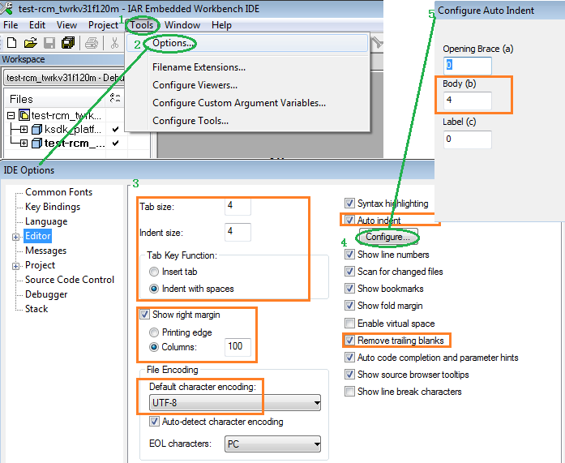
Formatting – Setting IAR editor to formatting code automatically
According the green steps, open the option configure window, and configure all the place which is in orange circle

Slide 17
Grammar rule

Slide 18
Grammar rule - Code in pairs
Braces, parentheses come in pairs
write the left side of the braces and then immediately write the right side
then insert the code into the braces.
When dynamically apply for memory
allocate a block of memory and then immediately write free function of release the block of memory
then insert the code what you want to use the memory to do in the middle of malloc() and free() function.

Slide 19
Grammar rule - Header
The header file contains only declarations, and is included by the .c file for the module.
Put only structure type declarations, function prototypes, and global variable extern declarations in the .h file;
Put the function definitions and global variable definitions and initializations in the .c file;
The .c file for a module must include the .h file
The content of a header file should compile correctly by itself.

Slide 20
Grammar rule - Header
Every header file should include every other header files that it requires to compile correctly, but no more.
Do not include header files that only the .c file code needs.
E.g.
<string.h> is usually needed only by the function implementations,
#include it in .c file, not in the .h file.
Set up global variables with an extern declaration in the header file, and a definition declaration in the .c file.

Slide 21
Grammar rule - Header
Two suggestions:
If the X.h file is a logically unavoidable requirement for the declaration in A.h to compile, then #including it in A.c is redundant, since it is guaranteed to be included by A.h. So it is OK to not #include X.h in A.c.
Always #including X.h in A.c is a way of making it clear to the reader that we are using X, and helps make sure that X’s declarations are available even if the contents of A.h changes due to the design changes.

Slide 22
Grammar rule - Header
Header file including order:
#include <stdlib.h> // Always include library header files first using <>
#include "fsl_hal_<self>.h" // Then include header files(hal or driver) of current module
#include "fsl_hal_<other>.h" // Finally include header files of other module

Slide 23
Grammar rule - Avoid
In assignment statement, the two sides of the different data types. (if indeed must be, should convert the type explicitly )
Remove the break statement in the switch case statement (unless two or more case handling code is completely consistent, at this time should be comments. )
Avoid unnecessary global variables.
Global variable only referenced in a C file, should use static key word.

Slide 24
Grammar rule - Variable
All local variables used inside function should be defined at the beginning of function, unless the variable is only used inside #define wrapper.
The related Variable declaration on adjacent lines.
A variable place in a line, unless specified variables are closely related.
Use const keyword for the constant variables.
As far as possible in line with the variables of initialized to the variable.
Avoid unnecessary global variables.
Global variable only referenced in a C file, should use static key word.

Slide 25
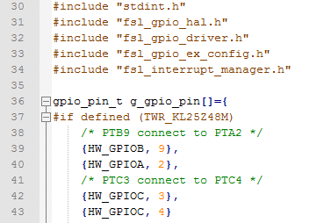
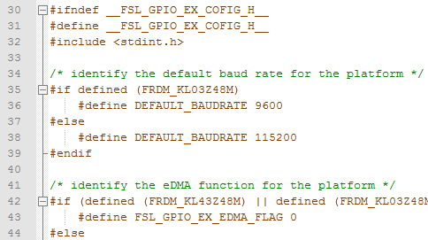
Grammar rule - portability
Define Macro to wrap boards related code
Define in mcu_PSDK_test\conformance\<module>\<module>_example\src\
fsl_<module_name>_ex_config.c
fsl_<module_name>_ex_config.h
fsl_gpio_ex_config.c
fsl_gpio_ex_config.h

Slide 26
Grammar rule - portability
Use feature Macro is better than board information
#if defined (FRDM_K64F120M)
#include "fsl_rtc_hal.h"
#include "fsl_rtc_common.h"
#endif
#ifdef __HW_RTC_REGISTERS_H__
#include "fsl_rtc_hal.h"
#include "fsl_rtc_common.h"
#endif
#if defined (FRDM_K64F120M)
void test_setChainMode(void);
#endif
#if FSL_FEATURE_PIT_HAS_CHAIN_MODE
void test_setChainMode(void);
#endif

Slide 27
Comments

Slide 28


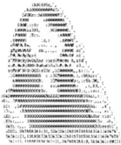
Comments
Copyright
User Guide
Function
Comment

Slide 29
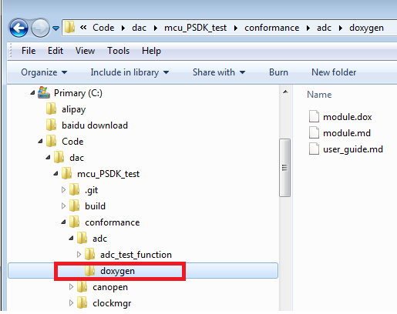
Comment
Copy doxygen folder
from path:
mcu_PSDK_test\doxygen
to path:
mcu_PSDK_test\conformance\module\module_example

Slide 30
Copyright comment
Exist in every file
At the head of every file
To do:
/*
* Copyright (c) 2014, Freescale Semiconductor, Inc.
* All rights reserved.
*

Slide 31
User Guide comment - How to use it?
Step1: go to mcu_PSDK_test\conformance and run
ruby doc_gen.rb
Step2: Start doxygen and open doxyfile under
mcu_PSDK_test\conformance\doxyfile
Step3: Click run and click “Show HTML output”
or go to mcu_PSDK_test\doc and double click index.html

Slide 32
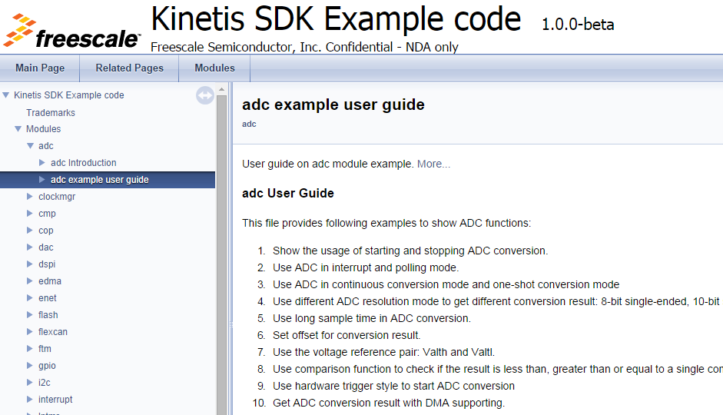
User Guide comment - How to use it?
Or go to mcu_PSDK_test\doc and double click index.html

Slide 33
User Guide comment
Code exist in *_main.c file
Follow Copyright
Including 3 parts:
#Overview# - brief author version
#Description# - Introduction of the module
Notes of the module
#User Guide# - Description of each test case
Pin connection
Board rework

Slide 34
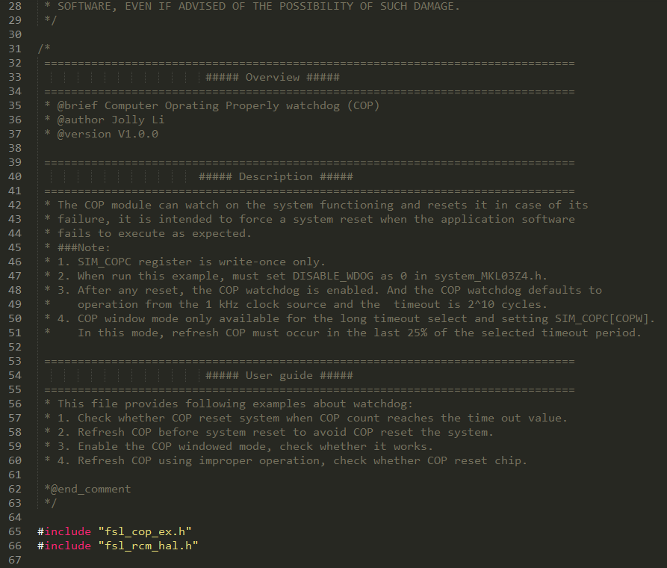

Slide 35
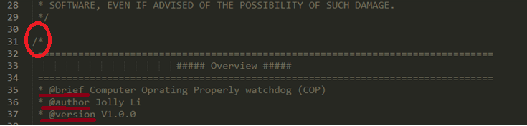
Overview

Slide 36
Description

Slide 37
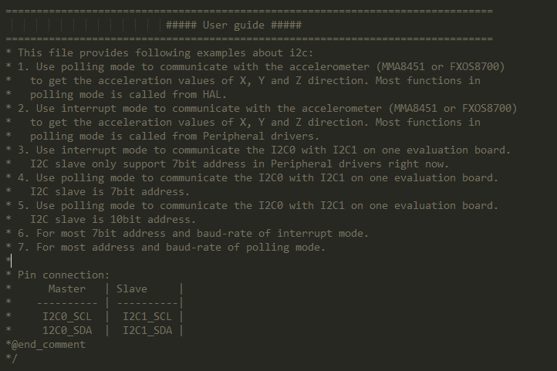
User Guide
Test case description
Pin
connection
End flag

Slide 38
Function comment
Each function must have comments, even if the function only has a few lines.
Comments before each function, including the function description, parameters and return values.
A blank line is required after the end of every function definition
Example:
/**
* @brief wait for the eDMA transfer complete.
* @param channel eDMA channel
* @retval true the transfer complete
* false the transfer not complete
*/
bool waitEdmaComplete(uint32_t channel)
{
…
}
//Blank Line

Slide 39

Comment Rules
1. Comment rate >20%
2. Place comments adjacent with the code, can be placed above or to the right the code, but not below the code.
3. Use multiline /* ... */ comments for all functions, structs, and classes in order to align with MISRA. There must be a space between the start of the comment and the first character of the comment.
4. Comments must be properly capitalized and must be complete phrases, Avoid to use abbreviations, especially abbreviations which not used commonly.
5. Comments should be accurate, and easy to understand

Slide 40
MISRA C Coding Standard
MISRA - Motor Industry Software Reliability Association
The standard includes 127 rules for C programming
Generally speaking, if complying with these standards,
C code is readable, reliable, portable and easy to maintain
IAR including141 items (MISRA-C:2004)
1.1:
1.2:
1.3:
.
.
20.12:
21.1:

Slide 41
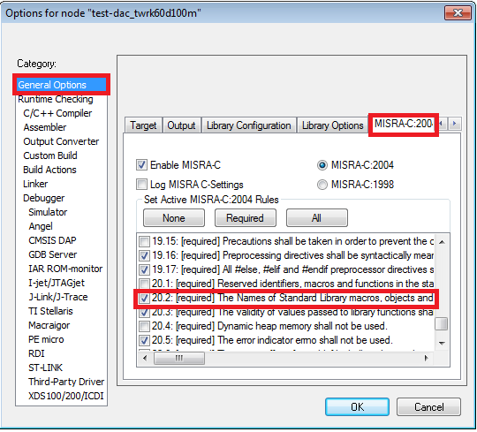
MISRA C Coding Standard

Slide 42
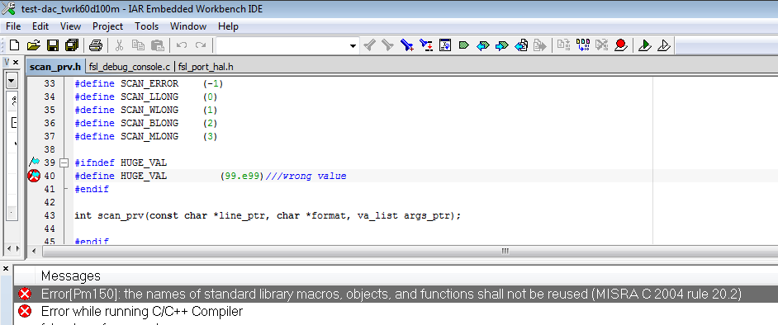
MISRA C Coding Standard

